Slide 1

The Battle of Neighborhoods – New York City IBM Applied Data Science Capstone
Presented by: Ningxin Xu

Slide 2

Introduction
NYC is the most populous city in the United States with an estimated 2019 population of 8,336,817 distributed over about 302.6 square miles (784 km2)
Its neighborhood contains all kind of restaurants with different categories, such as Chinese, Indian, Italian food etc., which provides me enough data and choices to do the analysis

Slide 3
Business problem
find the best place to open a new Japanese restaurant
List and visualize all Japanese restaurants in five boroughs.
1
Find which borough has the most potential Japanese food market.
2
Find where the best place is for a newly opened Japanese restaurant in NYC.
3

Slide 4
Data sources
1. New York City data that contains list Boroughs, Neighborhoods along with their latitude and longitude.
- number of total existing restaurants in each borough (any type of restaurant).
- number of Japanese restaurants in the neighborhood.
2. Four-square API as the prime data gathering source as it has a database of millions of places

Slide 5

Data Analysis

Slide 6
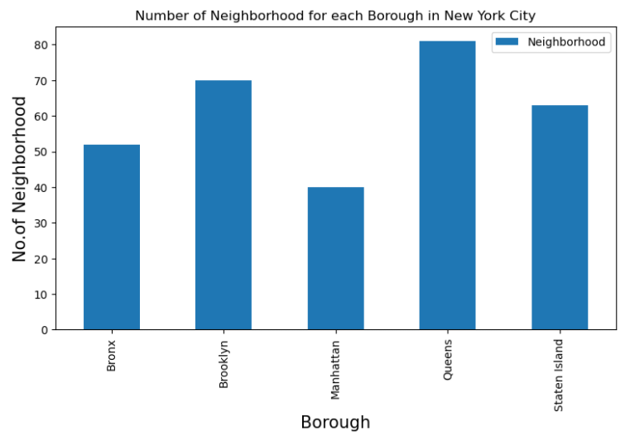
New York City has 5 boroughs and 306 neighborhoods in total
Queens has the greatest number of neighborhood;
Manhattan has the least neighborhoods.

Slide 7
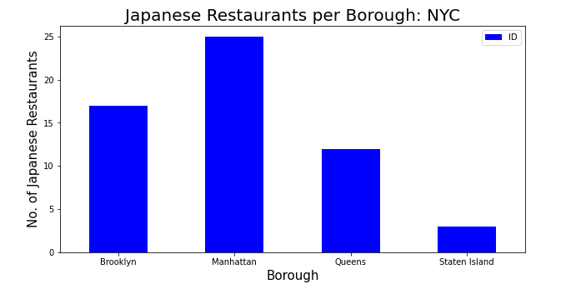
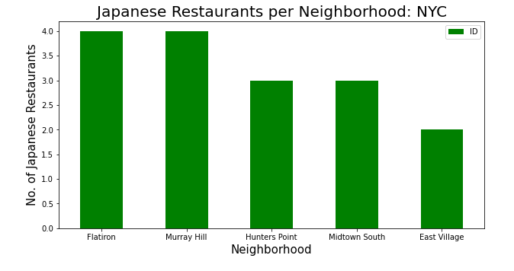
- Manhattan has the most Japanese Restaurants
- Staten Island has the least restaurants.
Flatiron and Murray Hill have the greatest number of restaurants
both neighborhoods are from Manhattan
There are totally 57 Japanese restaurants in 5 boroughs

Slide 8
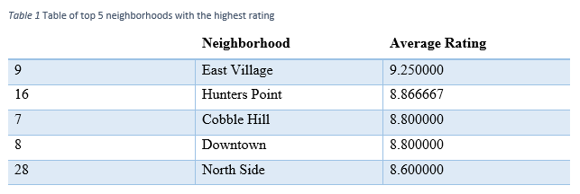
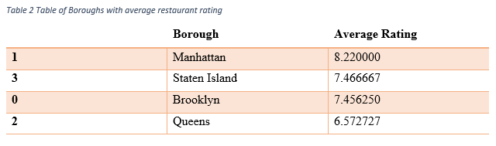
Rating, likes & tips
Morimoto from Manhattan has the maximum likes and tips
Suki Curry from Manhattan has the highest rating.
East Village has the highest average rating
Manhattan has the highest average rating with the most Japanese restaurants
Queens has the least average rating with only 6.57.

Slide 9
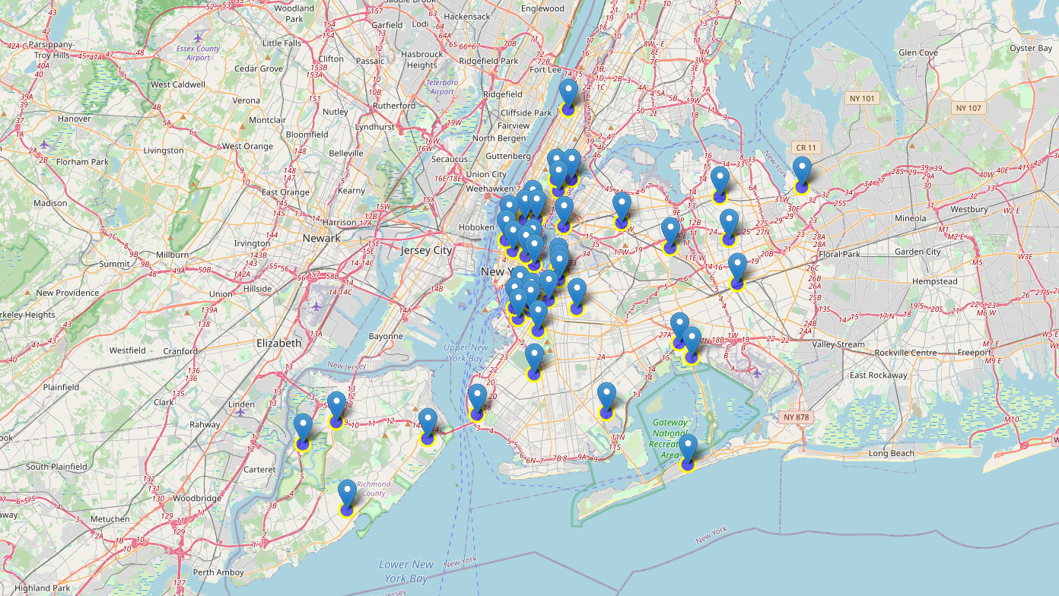
A new York city map with Japanese restaurant with rating > 8.00

Slide 10
Conclusion
For business starters:
1. Manhattan may be a good choice to open a new Japanese restaurant. Though Manhattan has already had many Japanese restaurants, its great location and busy population could help you to have a better customer volume compared with other boroughs.
2. Staten Island is also suitable for a new Japanese restaurant, because it has the least number of Japanese restaurants and may have a large potential market.

Slide 11
Conclusion
For Japanese food lovers:
Manhattan could always be the right place to go if you want to enjoy the most traditional and highly appreciated Japanese restaurants;
Be aware of Japanese restaurants in Queens since overall, they do not have a good performance.

